Slide 1
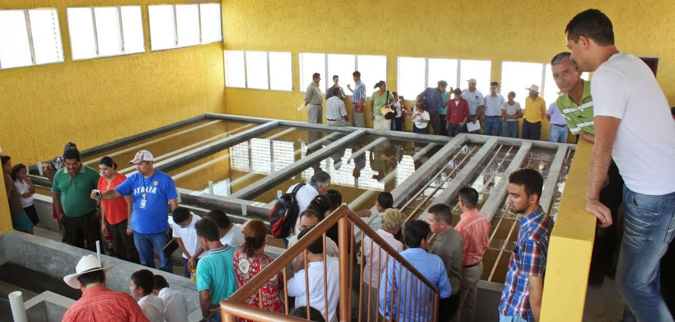
An Elegant Solution for Safe Water on Tap
Monroe Weber-Shirk
Notes:
Add intro to each unit process to help students think about projects

Slide 2
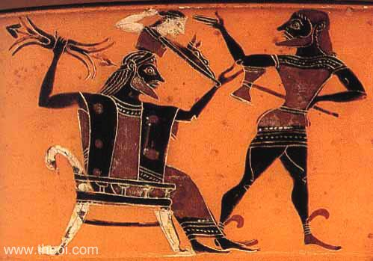


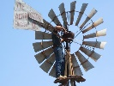

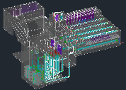
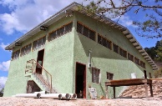
Overview
How to Innovate and Design
The AguaClara Consortium
High-tech and Elegance
Pride of ownership
AguaClara technologies and plants
Philosophy and Reflections
Ctrl + click the pictures to go each section!

Slide 3
Overview
How to Innovate and Design
The AguaClara Consortium
High-tech and Elegance
Pride of ownership
AguaClara technologies and plants
Philosophy and Reflections
Ctrl + click the pictures to go each section!

Slide 4
Recognize the edge of knowledge
Empirical design
No connection between theory and design parameters
No equations that describe performance based on theory
Complicated explanations that require multiple mechanisms to be operative
Process descriptions that don’t connect with physics
Data doesn’t match the “theory”

Slide 5
Three ideas…
Evolution – Iteration – Mistakes - Learning
Water treatment is about the complex interactions between fluids, particles, and geometry (beyond rectangular tanks!)
Success requires understanding the details!
Density currents caused by temperature change
Flow distribution to reduce mean currents
A roof to protect operators and the plant
Notes:
Microbes are awesome particles!

Slide 6
Inventing Perfection
“Furthermore, as the full scale plant is already in operation, the need for further design changes is not clear.” -(Anonymous Reviewer)
Ideas spring fully formed from their creator’s mind?
Athena leaped from Zeus's head, fully grown and armed
http://designserver.cee.cornell.edu/Designs
Notes:
What about iteration and feedback?

Slide 7
Overview
How to Innovate and Design
The AguaClara Consortium
High-tech and Elegance
Pride of ownership
AguaClara technologies and plants
Philosophy and Reflections
Ctrl + click the pictures to go each section!

Slide 8










AguaClara Consortium
R&D
Transfer
Implementers
Operate
Market
Municipalities
Implementers
Water Boards
Implement
Finance
Municipalities

Slide 9
Overview
How to Innovate and Design
The AguaClara Consortium
High-tech and Elegance
Pride of ownership
AguaClara technologies and plants
Philosophy and Reflections
Ctrl + click the pictures to go each section!

Slide 10
Simple, Elegant, or Complicated?
“Any intelligent fool can make things bigger, more complex, and more violent. It takes a touch of genius — and a lot of courage – to move in the opposite direction.” --- E.F. Schumacher
“Simplicity is the ultimate sophistication.” --- Leonardo da Vinci

Slide 11
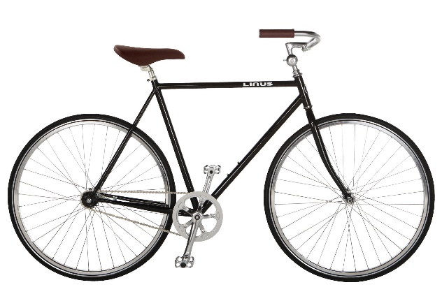

Elegant Solution
Solves the problem very well
No unnecessary complexity
Easy to understand
Simple and beautiful
Bicycle
Windmills
Context matters in defining elegant!

Slide 12
Overview
How to Innovate and Design
The AguaClara Consortium
High-tech and Elegance
Pride of ownership
AguaClara technologies and plants
Philosophy and Reflections
Ctrl + click the pictures to go each section!

Slide 13
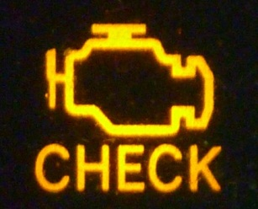
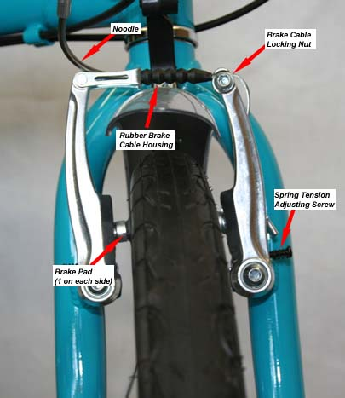
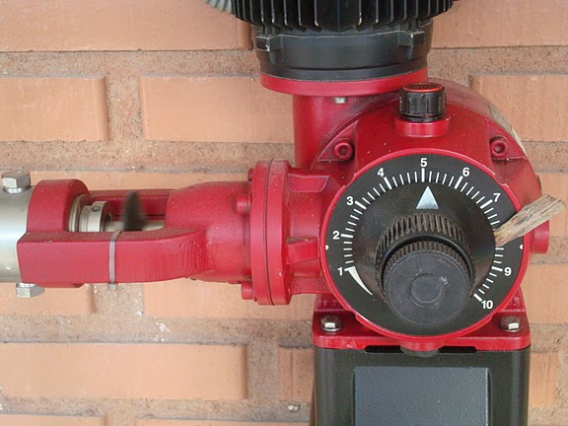
Pride of Ownership
What happens when the check engine light goes on in your car?
What do you do if your bicycle brakes need to be adjusted?
What does the plant operator do if the chemical feed stops working?
We want the plant operator to diagnose and fix the problem without needing to call anyone.

Slide 14
Overview
How to Innovate and Design
The AguaClara Consortium
High-tech and Elegance
Pride of ownership
AguaClara technologies and plants
Philosophy and Reflections
Ctrl + click the pictures to go each section!

Slide 15
Overview
How to Innovate and Design
The AguaClara Consortium
High-tech and Elegance
Pride of ownership
AguaClara technologies and plants
Philosophy and Reflections
Ctrl + click the pictures to go each section!

Slide 16
Three Key Ideas
AguaClara is open source engineering:
Many inventions, ZERO patents
Our technologies are described on our website and published in the literature.
Our example designs are available on the web!
Our technologies use ZERO electricity (except for batteries in the turbidimeters)
Our innovation is based on feedback and ongoing connections with plant operators

Slide 17
Resilience
We sometimes make the mistake of designing for steady state and forgetting about startup (NYC blackout in 1977
The USA has had stability for decades
Climate change is changing that
A breakdown in global trade could block replacement parts
Water supply is critical infrastructure and should be designed for resilience and rapid recovery after a disaster

Slide 18

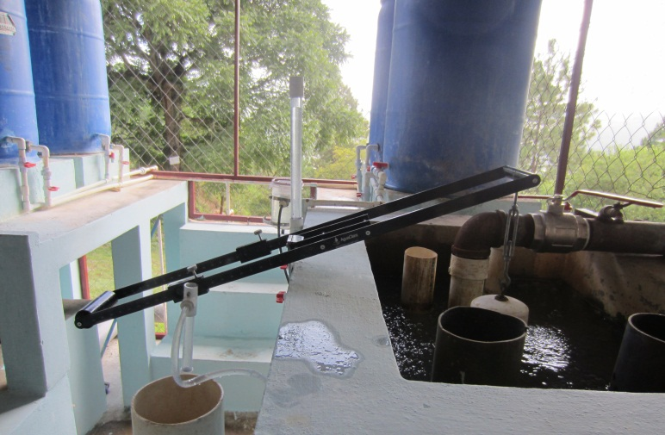
How Much Does it Cost?
*Quick and rough cost estimates.
Implementation COST
$100,000 + $8000 per L/s of capacity*
OPERATING COST
$5 per person per year
or $50 per million liters
ELECTRICITY COST
ZERO
Notes:
Quick and rough cost estimates.

Slide 19
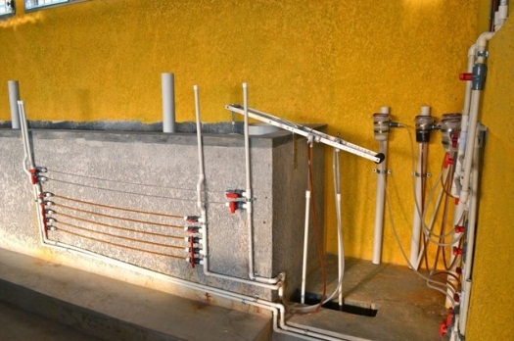
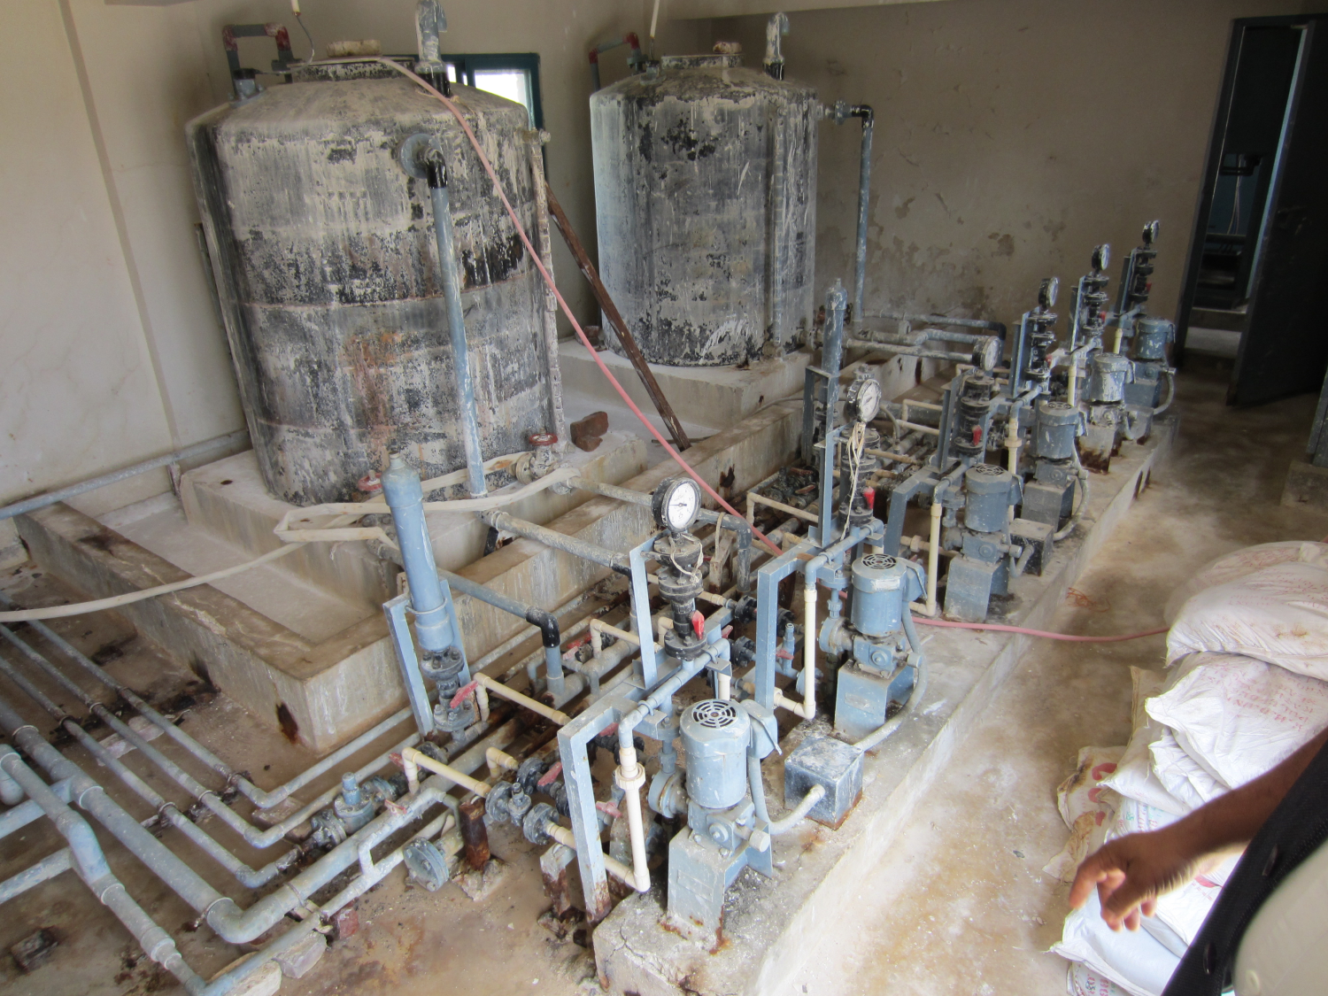
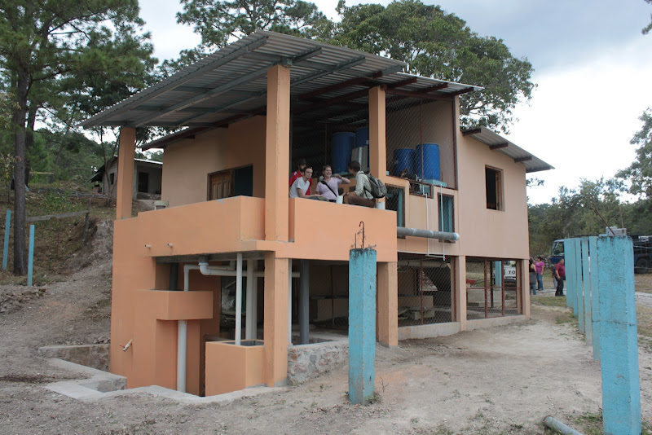
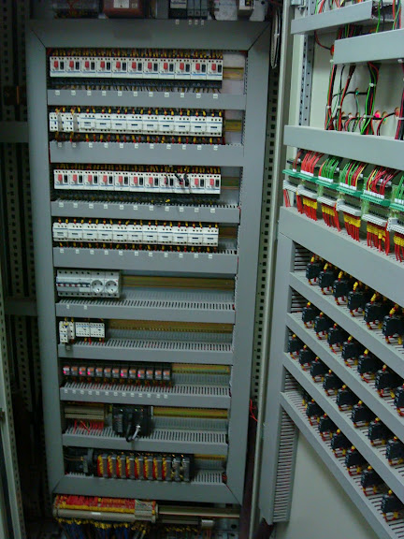
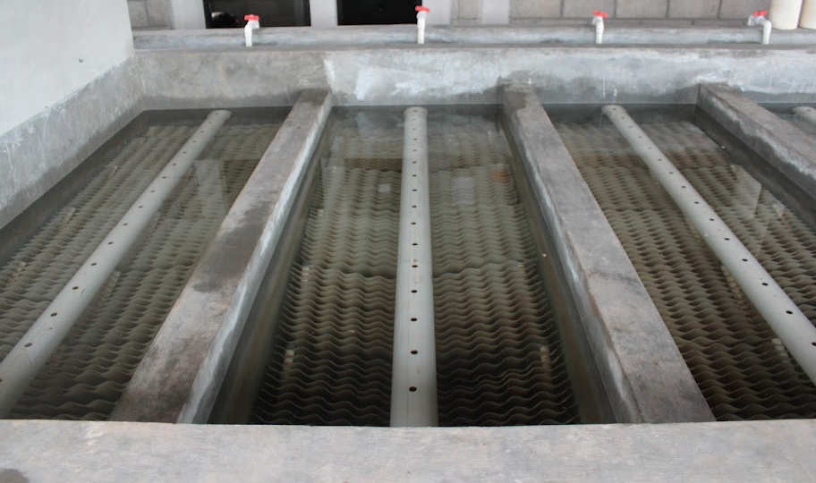
Reflections
Technology and Engineering Philosophy matter!
Infrastructure failures are linked to design choices
We design for Simplicity on the other side of Complexity

